Slide 1
Predicting Soccer Transfer Prices
By Meehir Pathare

Slide 2


Slide 3





Data Acquisition

Slide 4
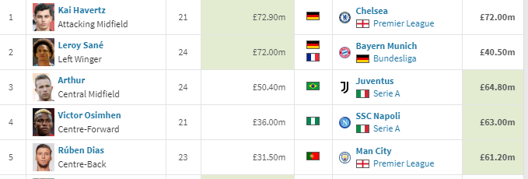
Data Acquisition

Slide 5
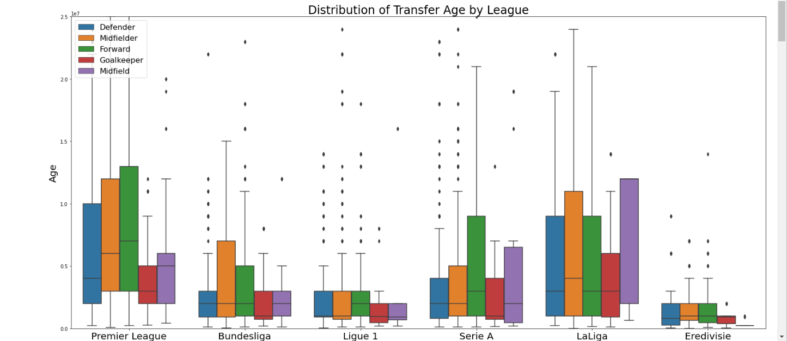
EDA

Slide 6
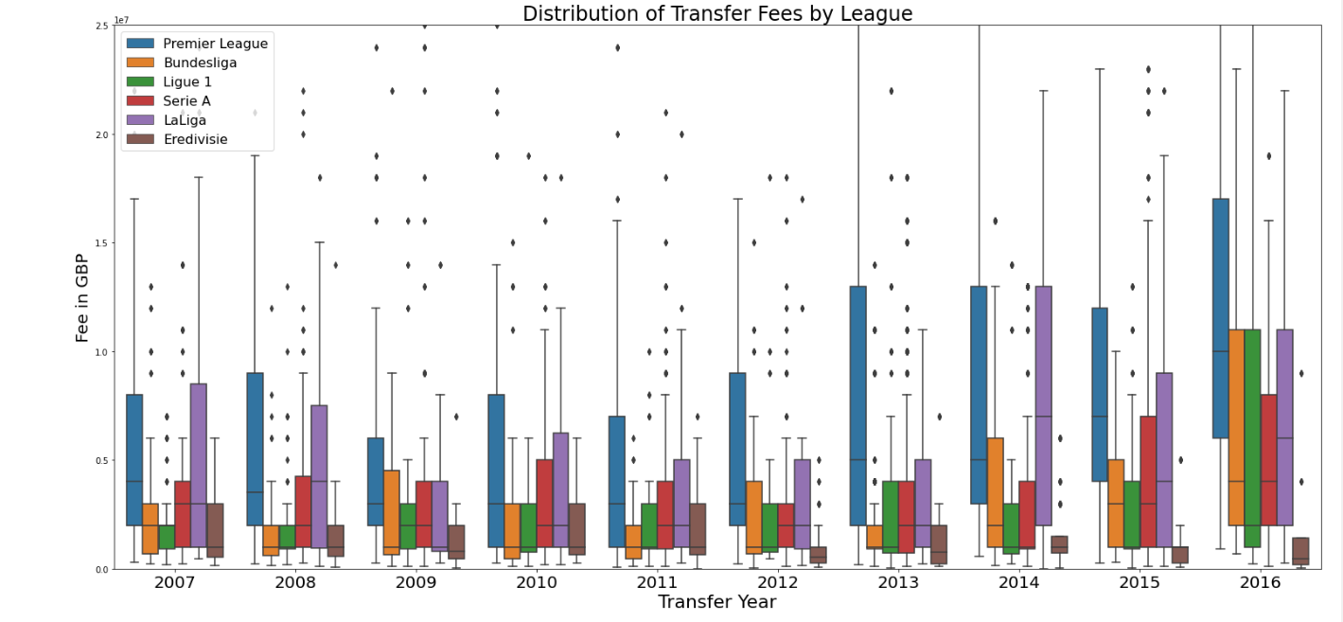
EDA

Slide 7
Preprocessing
Target Variable: Transfer Fee in GBP
No free transfers
Match time with Kaggle & Transfermarkt
Consolidate Categories

Slide 8
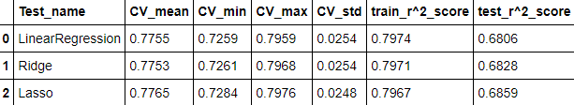
Modelling
~ 10, 000 Transfers
52 features
  demographics
  FiFA stats
Individual and Team Features

